Slide 1

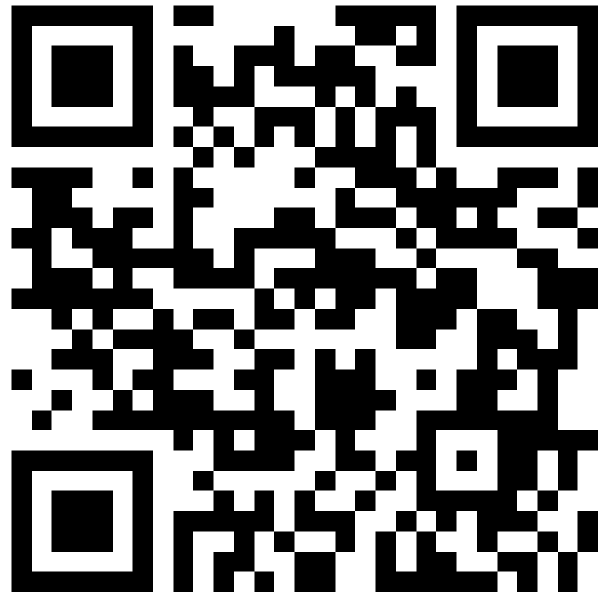
Assessment 2 Briefing
COMSM4111 Robotic Systems
Anonymous Feedback form:
https://forms.gle/PyQQy2mwzyATFmJW6
Padlet board (questions & comments):
http://padlet.com/paul_odowd1/1lhoodwv2fuc
Delivered by:
Paul O’Dowd paul.odowd@bristol.ac.uk

Slide 2
House Keeping
Assessment 1 – well done.
Assessment 2 Library released after this lecture. It will be password protected.
Assessment 2 Maps: Trial a 24 hour loan system email me to arrange collection.
Formative Experiment Proposals:
Wednesday 20th November, feedback by Friday 29th November.
Email: paul.odowd@bristol.ac.uk
Mid-term Evaluation is open on Blackboard

Slide 3
Lab Sessions / Sheets
Reading Week
Week 8
Week 7
Week 9
Week 10
Week 11
Week 12
2 Hour Drop-in
2 Hour Drop-in
2 Hour Drop-in
2 Hour Drop-in
Lectures
Experimental Robotics
1 Hour Drop-in
1 Hour Drop-in
1 Hour Drop-in
Assessment 2 Briefing
1 Hour Drop-in
1 Hour Drop-in
1 Hour Drop-in
Toward
Assessment 2
Assessment Op 3
Formative
Proposal
Submission
Formative Proposal Feedback
(3 Hours) Demo / Feedback
Report Submission

Slide 4
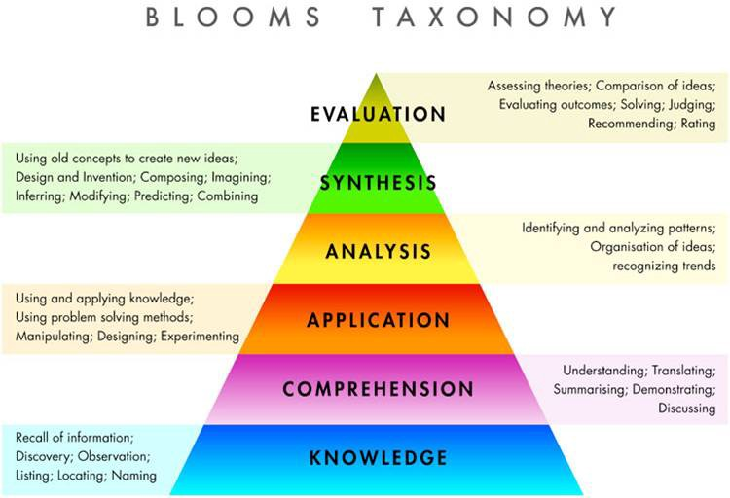
Assessment 2
Assessment 1

Slide 5
Assessment 1 ✔
Line Following
Analysis of Systems
Real-time operation
Software For Hardware
Finite State Machine
Line Following
Debugging Robots
PID
Encoders
Kinematics
Millis()
Motors
Time & Speed

Slide 6
Assessment 2
Conduct an Experiment
Improvement
Problem
Comparative
Analysis
+ Skills
Line Following
Finite State Machine
PID
Encoders
Kinematics
Millis()
Motors
Time & Speed

Slide 7
Rationale
Experimental
Method
Key
Implementation
Characteristics
Hypothesis
Experiment 1
Baseline / Control
Experiment 2
(comparison)
(demo)
Area of Improvement
Results, Discussion, Evaluation
Write a Report:
Using mapping performance as a key context/metric

Slide 8
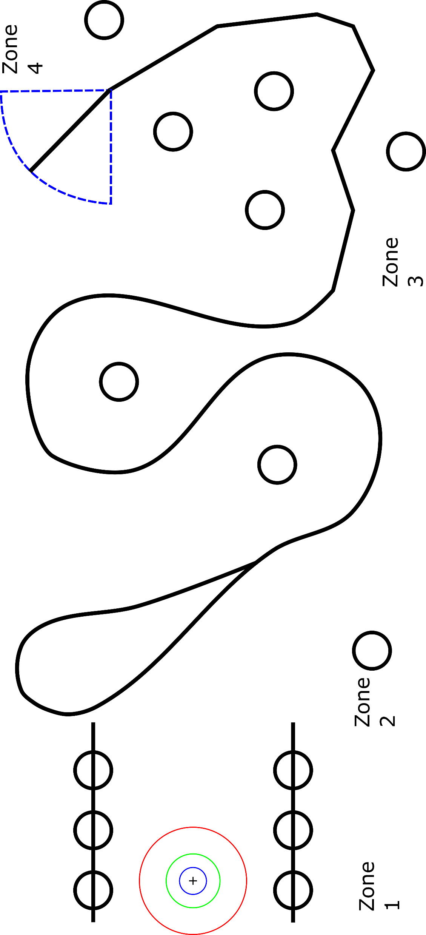
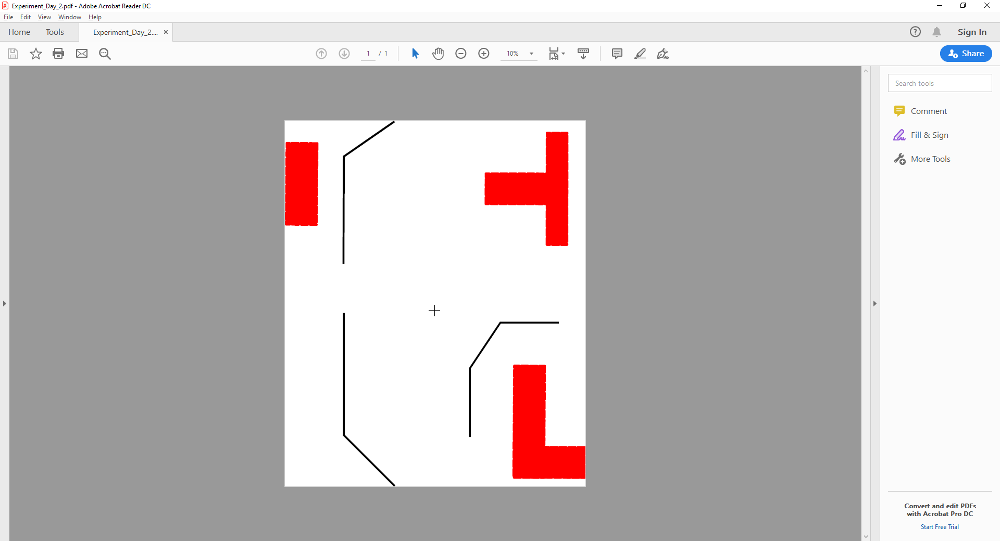
Maps
(shiny)
(shiny)
24 Hour Loan – email me to arrange collection.
Maps might be useful for a consistent environment.
Shiny maps can be drawn on.
You may wish to use physical obstacles.
You are free to define your own maps.
I have a lot of black vinyl tape.
x9
x4
x4

Slide 9
EC FP7:Open Questions for Robotics Research:
observable, repeatable, and objective
How to decompose into components or sub-components?
Write about which sub-component you have selected, how you believe this influences the whole system, and therefore why it is of interest.
How to evaluate a complex system?
Detail your experimental method such that someone:
values your work
could recreate your work.
Experimental parameters, independent/dependent variables.
Baseline/control experiment -> second experiment.
How to define suitable metrics?
Describe how you will evaluate performance between your two experiments – the rationale for your choice of metric (e.g., why is it appropriate?), and the limitations.
Appropriate: how does it help to isolate performance?
Limitations: what are confounding variables? Do you need a second metric?
http://www.heronrobots.com/EuronGEMSig/downloads/Zaragoza/RSS2010-Benchmarking-AnneBAJART.pdf
Notes:
2 -> Complicated vs Complex. Complex systems have an high inter-relation, feedback, emergence. Complexity goes up as we get closer to reality.
4 -> Falsifiability, aim to disprove, not to prove. Darren Brown.

Slide 10
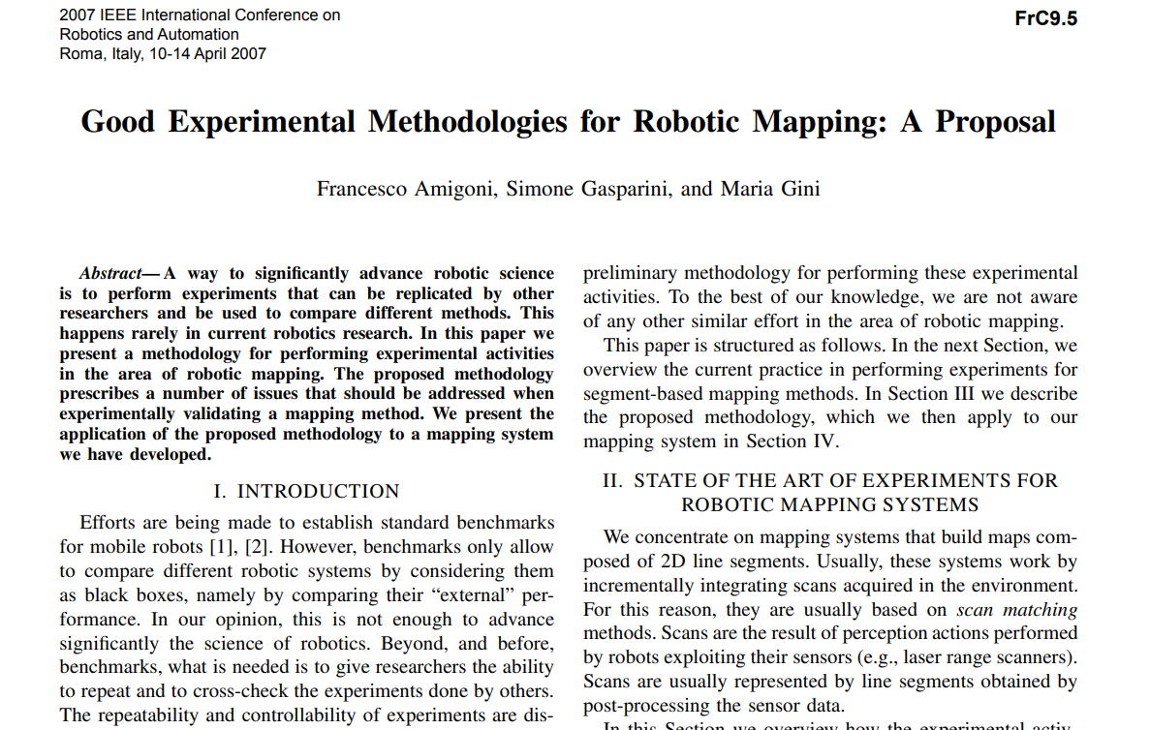
Robotic Mapping
https://www-users.cs.umn.edu/~gini/publications/papers/Amigoni07icra.pdf

Slide 11
Common Formative Feedback:
You have described your implementation, but not the rationale behind it. It was not clear to me how you expected the implementation to lead to an improvement in performance.
You have described your implementation, but some parts are unclear.
You have introduced a range of metrics, but not clearly defined them.
You have introduced a range of metrics, but there is no discussion of their limitations.
You have relied on a single metric to assess performance.
You have only introduced qualitative metrics.
Your report lacks a depth of analysis (e.g. “pretty good performance”)
You have evaluated your subsystem, but not the baseline. As such you cannot put your results in context.

Slide 12
Assessment 2 Library
Calibrate
Drive Straight
Turn to 90*
Random Walk
Initial State
Turn to 0*
Avoid Obstacle
Follow Line

Slide 13
Assessment 2 Library
Setup()
Loop()
Detect line*
changeState()*
Detect obstacles*
switch( state )
behaviourX()
behaviourX()
behaviourX()
behaviourX()
behaviourX()

Slide 14
University Rubric
http://www.bristol.ac.uk/academic-quality/assessment/regulations-and-code-of-practice-for-taught-programmes/marking-criteria/

